Slide 1
IEOR 142 Final Project
Prediction of Stock Prices Using Machine Learning
Edward Bian, Jake Lamb, Sasyak Pattnaik, Ethan Wang, Jiefing Yang, Vincent Zhang

Slide 2


Background/Motivation
As data science, IEOR and economics students, we wanted to apply our knowledge towards a venture that was at the crossroads of these two disciplines
The goal of this project is to apply various machine learning techniques to predict the stock prices of Taiwan Semiconductor Manufacturing Company (TSM) and Nvidia (NVDA)
“Price changes only when Information changes” - Eugene F Fama
We chose TSMC and Nvidia as these two companies are very large, liquid, and highly connected to the global economy. We would be able to get good data for them and also compare them to each other
Notes:
Honouring the Economic Pioneer Eugene Fama, we believe in the Efficient market hypothesis from his research and our backgrounds in the economics departments, quote,
Edward

Slide 3

Concepts
We tried to predict daily closing prices using the data we gathered or put together
This timeframe was selected due to inherent characteristics of the market and what data we would be able to collect (1750 days of past data)
At shorter timescales (seconds/minutes), market behavior becomes basically stochastic and computational requirements increase dramatically
At longer timescales, the usability of results decreases and scope of prediction required increases unmanageably (it’s not possible to predict events like COVID or the war in Ukraine ahead of time)
Notes:
Edward

Slide 4


Data Collection/Cleaning
We collected stock data from yahoo finance
Binary Variables were inputted manually based on certain factors that are described in our data descriptions
We first scrape data from each ticker
Get rid of all min/max data, keeping only adjusted close
Get rid of null values
We then convert weekly data to be daily using Vlookup
Quarterly data is similarly converted to daily
We manually create and assign categorical data
Each separate data type is converted to short date in Excel for easy merging
We then use Jupyter to load and merge each csv file into new columns in one big combined table
Notes:
Jake

Slide 5

Dependant Variable (Y)
Variable | Data Type | Description
Date | Date | From February 15th, 2018 - December 1st, 2022
NVDA close | Double | Nvidia stock closing price (USD)
TSM Close | Double | Taiwan Semiconductor Manufacturing company stock closing price (USD)
We will be predicting the NVDA and TSM stock prices from the Independent variables in the next slide and its Historical price data.
Variable | Data Type | Description
Status | Int (-1,0,1) | Whether the stock is gonna go up, stay the same, or go down
Notes:
Jake

Slide 6

Independent Variable Descriptions (X)
Variable | Data Type | Description
Date | Date | From February 15th, 2018 - December 1st, 2022
Biden | Int (Binary) | 1 if Biden is the president of the United States
Covid (no Vax) | Int (Binary) | 1 if Covid has been declared a national emergency and there is no vaccine yet
First Vax | Int (Binary) | 1 if the first covid vaccine has been deployed and there is not a booster yet
Booster | Int (Binary) | 1 from the time of the booster to two months after
Ukraine | Int (Binary) | 1 if Russia has invaded Ukraine
Pelosi is Speaker | Int (Binary) | 1 if Nancy Pelosi holds office as the Speaker of the House of Representatives
NVIDIA 2000 release | Int (Binary) | 1 from the release of NVIDIA 2000 series to two months after
NVIDIA 3000 release | Int (Binary) | 1 when NVIDIA 3000 series released to two months after
NVIDIA 4000 release | Int (Binary) | 1 when NVIDIA 4000 series released to two months after
Notes:
Jake

Slide 7
Independent Variables Descriptions Continued (X)
Variable | Data Type | Description
Apple Close | Double | Apple Stock closing price (USD)
Nasdaq Close | Double | Nasdaq Composite Index closing price (USD)
Oil Close | Double | Oil Futures closing price (USD)
Treasury Close | Double | Treasury closing price (USD)
Bitcoin Close | Double | Bitcoin value closing price (USD)
TSM Earnings | Double | Latest Quarterly Earnings Per Share (EPS) for TSM
NVDA Earnings | Double | Latest Quarterly Earnings Per Share (EPS) for NVDA
GoogleTrend (TSM) | Double | Weekly variable for search interest of Nvidia(0~100)
GoogleTrend (NVDA) | Double | Weekly variable for search interest of TSMC (0~100)
Seasonality | Int (Binary) | Multiple dummy variables for the month and the week day
Notes:
Jake

Slide 8

Data Types
Most of our data is pricing (stock/future prices) or categorical, but we did include a few data types that are not as self-explanatory
Google Trends
Weekly variable for search interest that we converted to daily
Value scaled relative to the highest point on the chart for the given region and time. A value of 100 is the peak popularity for the term. A value of 50 means that the term is half as popular. A score of 0 means there was not enough data
Earnings data
Latest Earnings Per Share (EPS) for the company, new values are released quarterly
Indicator of company financial wellbeing
Notes:
Ethan

Slide 9

Time series analysis
In order to predict the future prices more accurately using historical data, we will also use the past prices as AR(x) models
We are using prices from a week before and 2 weeks before as another independent variable for both TSM and NVIDIA
We not using the prices of “yesterday” mainly because it been too close to the daily actual price and make it hard to compare models for accuracies
“Imagine it as weekly predictions but we enter with more daily data available” which makes the models more practical to the real world
In order to make it extra realistic, we shifted the testing data one day forward so we are actually “predicting” the stock.
Notes:
Ethan

Slide 10
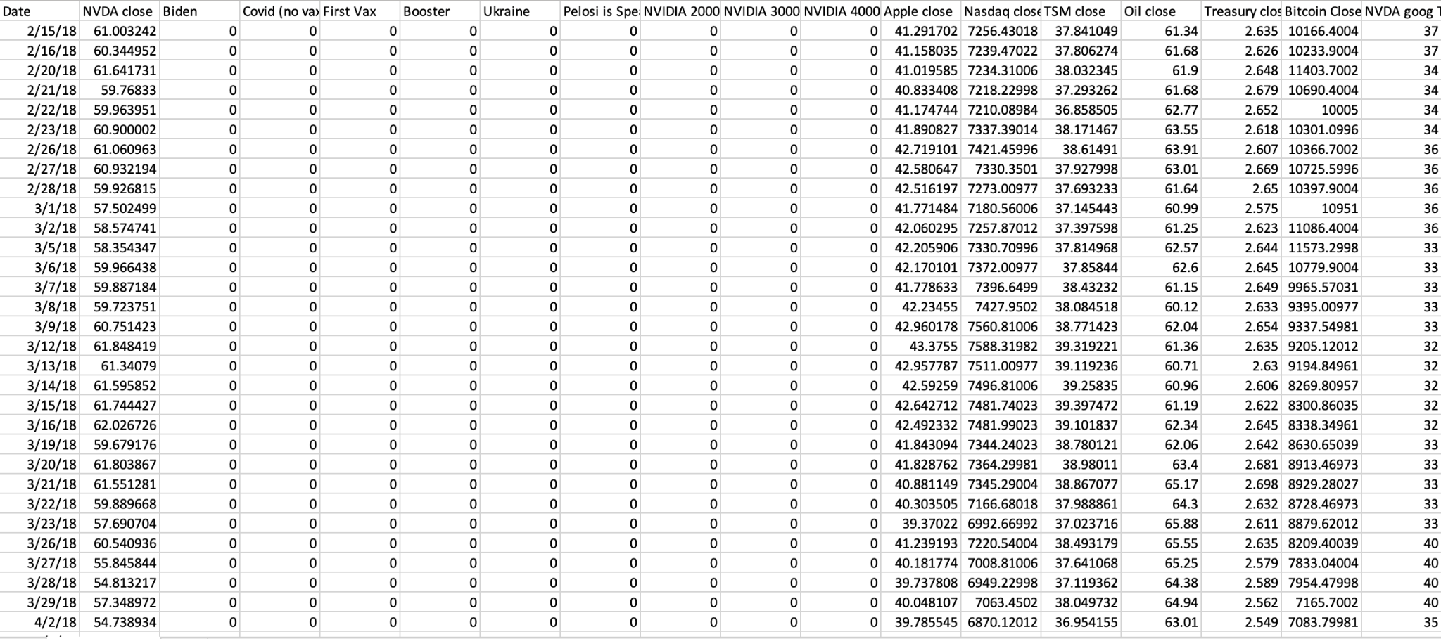
Collected Data
Notes:
Jake

Slide 11
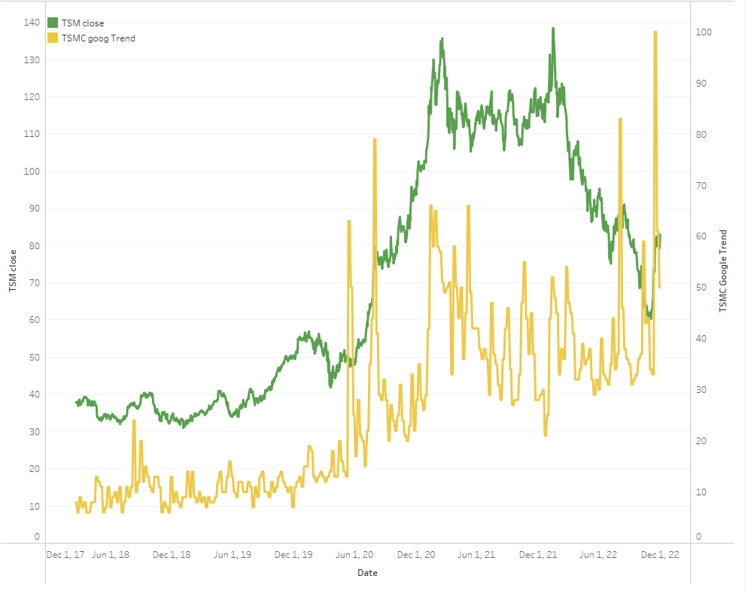
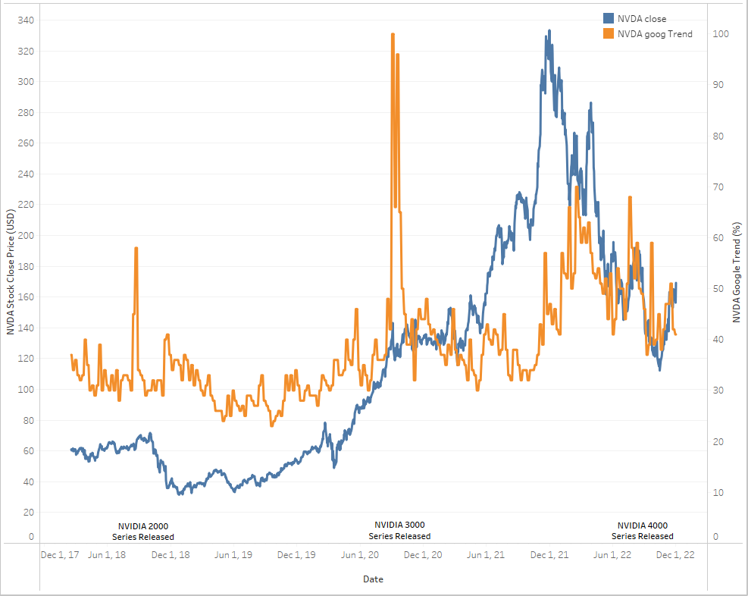
Exploratory Data Analysis
TSM
NVIDIA
Notes:
Jake

Slide 12
Model Concepts
Prices from 5 Days before
Baseline model
CART
CART can be used for numerical and categorical results
Linear Regression
Linear Regression can be used for predicting a continuous response variable
Random Forest
Random Forest can be used for numerical and categorical results
Logistic
Used for categorical
Neural Network
Extensive research and experimental for regression analysis
Notes:
Sasyak

Slide 13
Results Analysis
OSR²
Used to tell us how good the model performs on the test set
RMSE
Used to tell us how ‘close’ we are to the true value
StockTradeSimulator function
Simulates trading using the algorithm as guide and compares it to buying the stock and holding it
Ratio is (Algo return - Actual return) / Actual return
Notes:
Sasyak ½
Edward

Slide 14
CART Regression
Description: CART is a predictive ML algorithm which explains how the target variable’s values can be predicted based on other variables. It used a decision tree where each fork is split into a predictor variable and each node gives a prediction for the target variable.
Factors used: min_samples_leaf=5 ; min_samples_split=20 ; random_state=88
Performance:
NVDA: OSR² = 0.8619 ; R² = 0.9925
TSM: OSR² = 0.7059 ; R² = 0.9943
Trading Simulator:
NVDA Actual: 0.5783, Algo: 1.1528, Ratio: 0.9933
TSM Actual: 0.6319, Algo: 0.6837, Ratio: 0.0820
Notes:
Sasyak

Slide 15
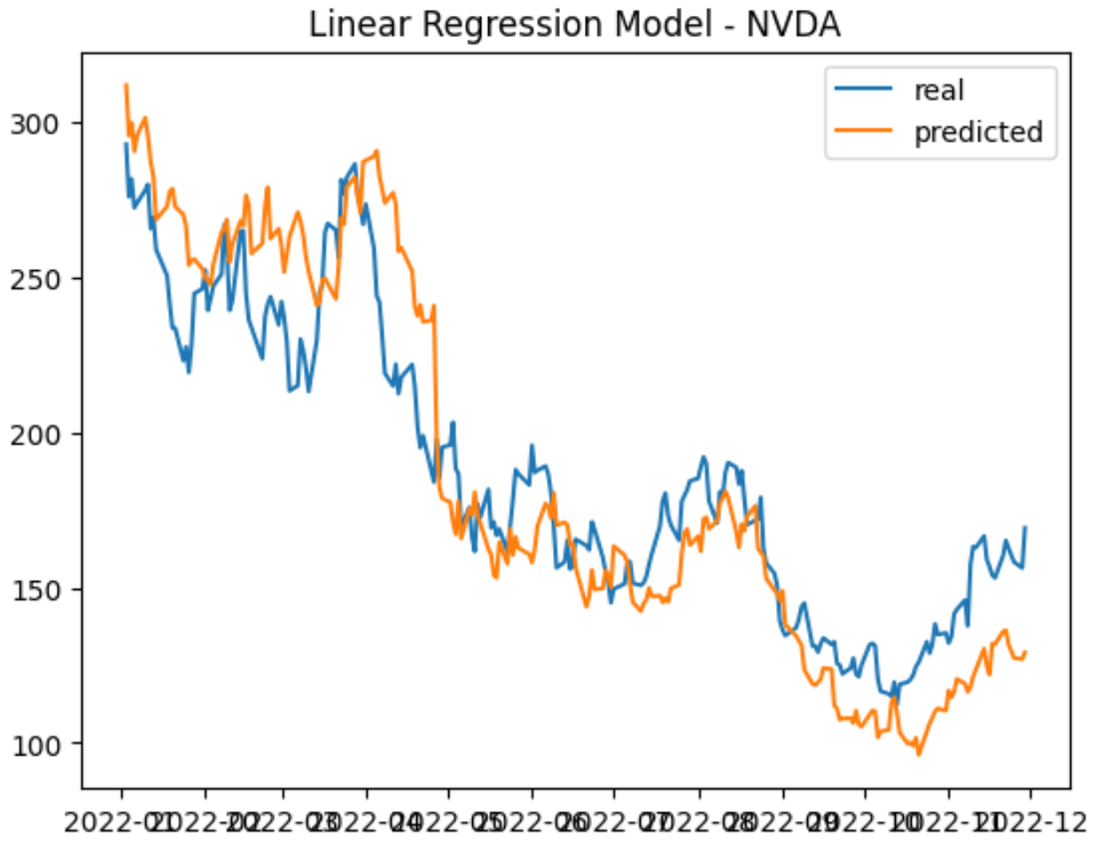
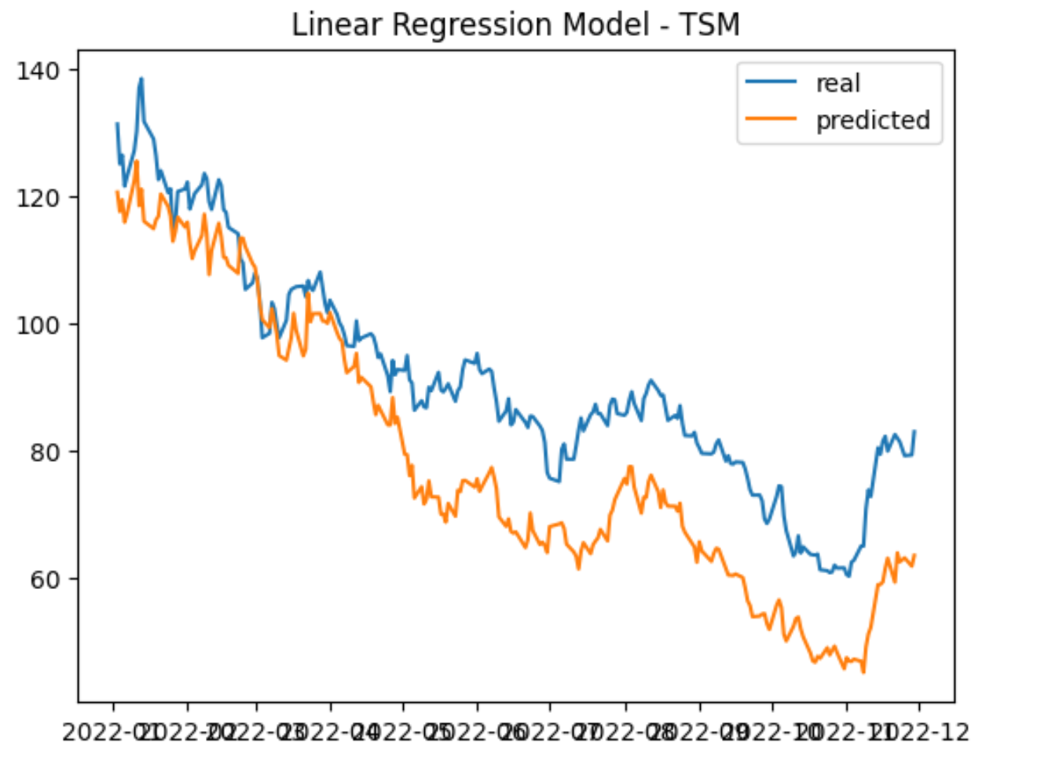
Linear Regression
Description:
a linear approach to predict a continuous response variable based on a set of independent variables .
Performance:
NVDA: OSR² = 0.9456 ; R² = 0.9895
TSM: OSR² = 0.7949 ; R² = 0.9915
Trading Simulator:
NVDA Actual: 0.5783, Algo: 1.1192, Ratio: 0.9352
TSM Actual: 0.6319, Algo: 1.1276, Ratio: 0.7845
Notes:
Ethan

Slide 16
Random Forest Regression
Description: Random Forest regression is a supervised learning algorithm which uses ensemble learning - a technique that combines predictions from multiple ML algorithms to make a more accurate prediction than a single model.
Factors used: max_features=15(NVDA)/13(TSM) ; min_samples_leaf=5 ; n_estimators = 500 ; random_state=88
Performance:
NVDA: OSR² = 0.9546 ; R² = 0.9969
TSM: OSR² = 0.7789 ; R² = 0.9972
Trading Simulator:
NVDA Actual: 0.5783, Algo: 0.6761, Ratio: 0.1691
TSM Actual: 0.6319, Algo: 0.6936, Ratio: 0.0977
Notes:
Sasyak

Slide 17
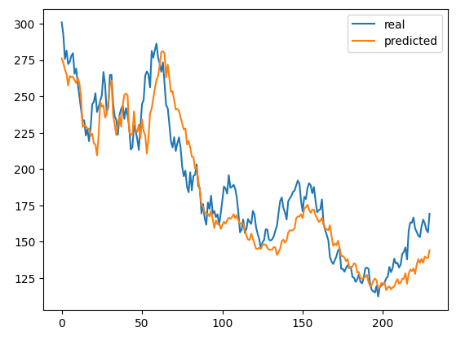
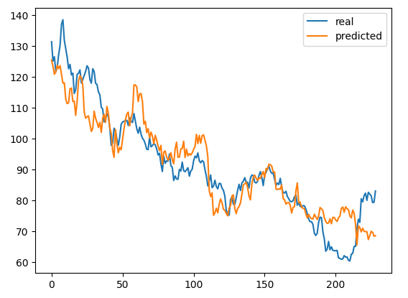
Neural-Networks
NVDA
Description:
Nonlinear method for compare and experimentation
Researched for the time series for Neural Nets
Factors used:
ReLU (Rectified Linear Unit) – Good for time series pattern
4 hidden layers after trials of loss
Adam (Adaptive Moment Estimation) - Momentum
Accuracy:
NVDA: OSR² = 0.94425 ; R² = 0.9073
TSM: OSR² = 0.9393 ; R² = 0.9357
Trading Simulator:
NVDA Actual: 0.5783, Algo: 1.0226, Ratio: 0.7683
TSM Actual: 0.6319, Algo: 0.8207, Ratio: 0.2988
TSM
Notes:
Edward

Slide 18
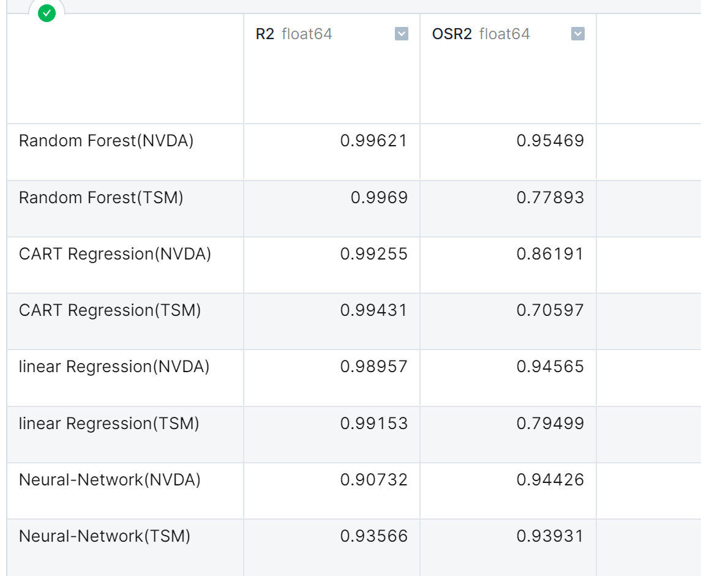
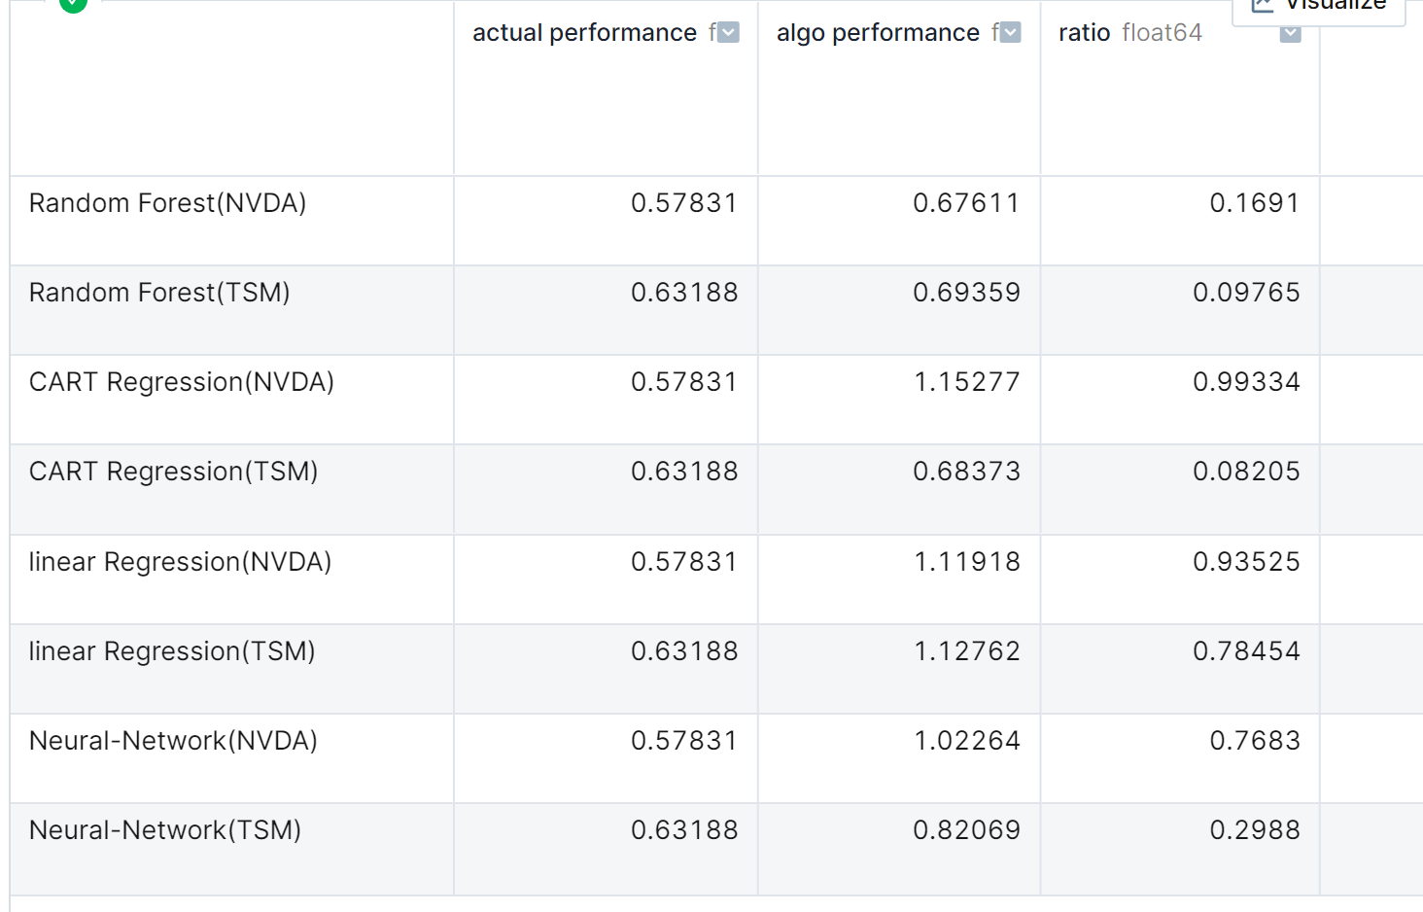
Comparison Table
Stock trade simulator
R2, OSR2
Notes:
Ethan

Slide 19
Model Selection
We chose Linear Regression because:
Interpretation ability
Easy time series implementation
Neural-net is better at accuracies and consistencies which is a really good contender
Logistic Regression was tested but not further explored as initial results were very poor and determined to be of ambiguous use.
Notes:
Sasyak

Slide 20
Impact
Models follow the trend really well considering we only using around 20 variables and only week-before prices
Our model can give ballpark trends on where NVIDIA and TSM stock prices will go for future dates
To improve the impact of the our models, we would need more variables with in depth research into what impacts these stock prices
The model represents a relatively robust short range indicator
Notes:
Sasyak

Slide 21
Shortcomings and improvements
Still difficult to use the models to make a profit, but it definitely provided insights for different models’ performance and the impact of different variables
StockTradingSimulator shows models are robust enough to ‘ride’ ups and downs in for profit in some cases
Models unable to respond to sudden events without prior warning (ie. another COVID), but are able to factor in existing changes with time
We would like to look into a more comprehensive feature discovery and selection system
Notes:
Jake

Slide 22
Appendix
Yahoo Finance - Stock Market Live, quotes, Business & Finance News. Retrieved December 2, 2022, from https://finance.yahoo.com/
Fama, E. F. (1965). Random walks in stock market prices. Financial Analysts Journal, 21(5), 55–59. http://doi.org/10.2469/faj.v21.n5.55
Shen, J., & Shafiq, M. O. (2020, August 28). Short-term stock market price trend prediction using a comprehensive deep learning system - journal of big data. Retrieved December 2, 2022, from https://journalofbigdata.springeropen.com/articles/10.1186/s40537-020-00333-6
Notes:
Ethan

